Slide 1
Hotel Recommendation System SpringBoard Capstone Project 1
Jonas Cuadrado
Sept 21st, 2018

Slide 2
Where are we going?
Travelers rely on flight and hotel searches to chose destinations
Many search engines lack personalization or don’t encourage it

Slide 3





Some inspiration

Slide 4
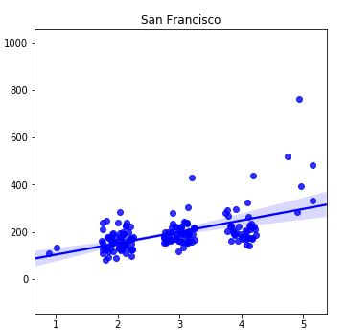
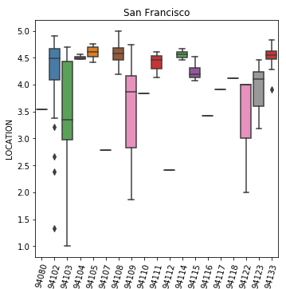
Let’s look at some data
price (USD)
location rating
stars
zip code
… but we don’t have individual ratings!!

Slide 5
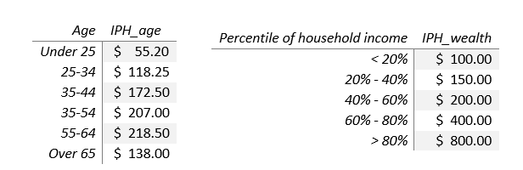
A model for ratings
1. Chose age and wealth
Ideal Price for Hotel (IPH) = 0.5 IPH_age + 0.5 IPH_wealth

Slide 6
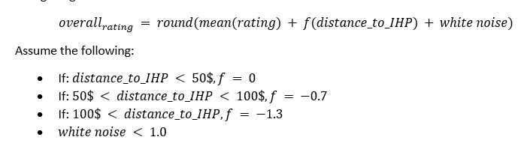
A model for ratings
2. Chose a hotel and look at the price. Define the distance to IPH as the difference between the hotel price and the IPH
3. Create a rating
4. Iterate until we have enough ratings

Slide 7
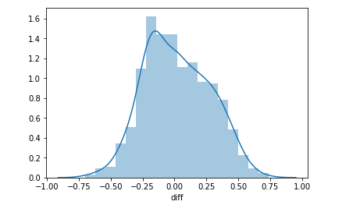
Make sure the mean ratings are not too off
Probability density
Difference between generated mean rating and real values

Slide 8
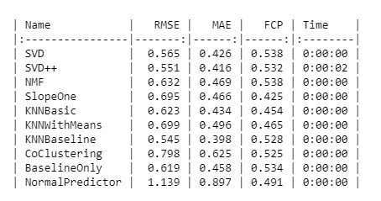
How to do recommendations
Use surprise toolbox
Compare different algorithms
Performance in unseen data

Slide 9
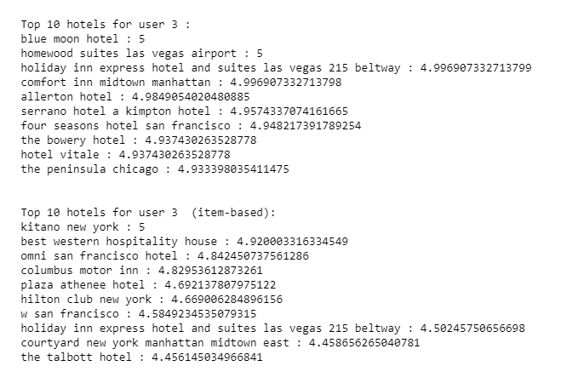
How to do recommendations

Slide 10
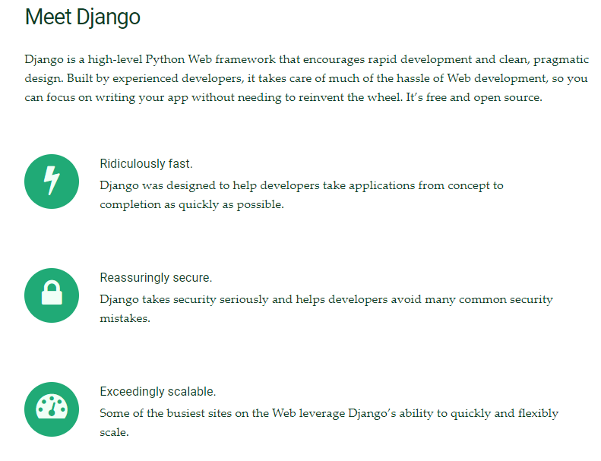
Creating the app

Slide 11
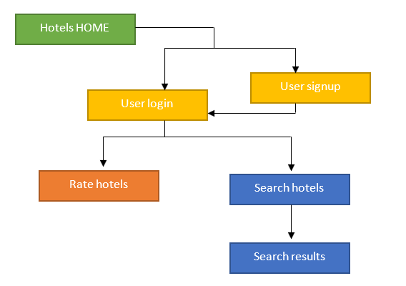
Creating the app
django automatically handles these
Requires user authentication
Doesn’t include additional links between parts
Saving data onto database
This is the previous codes

Slide 12

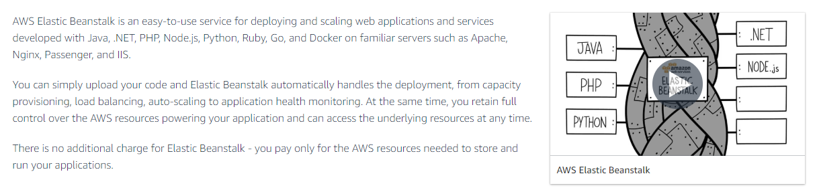
Deploying the app

Slide 13
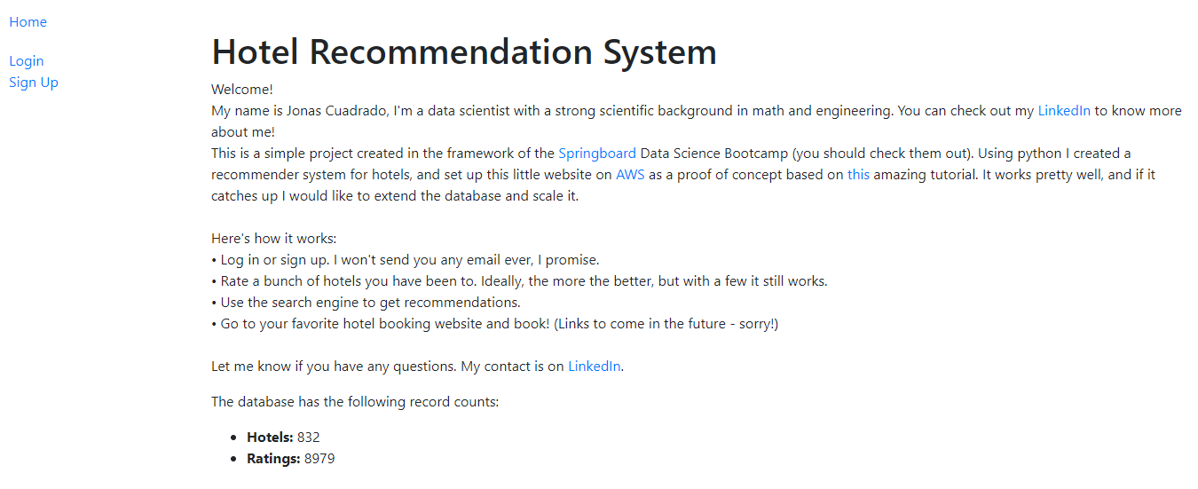
Final result
website

Slide 14
Conclusions / Future Work
In this project I have successfully created a recommendation system comparing different algorithms, performing qualitative analysis on raw data, generating consumer models and deploying it on cloud. There are many possible improvements, which include:
Using a multicriteria recommender to generate the most suitable hotels.
Changing the algorithms as data grows, eventually deleting the virtual ratings.
Adding style and formatting to the website.

